Slide 1
Core Java – Part 7

Slide 2
What we will cover today?
Overview of Thread
Thread and Runnable
Life Cycle of Thread
Synchronization
Notes:
http://tutorials.jenkov.com/java-concurrency/index.html

Slide 3
Thread Overview
In a single-threaded runtime environment, actions execute one after another. The next action can happen only when the previous one is finished.
Some actions like downloading should happen in the background (that is, in another thread). That way, other processes could happen at the same time
The reason multithreading is still used in spite of its challenges is that multithreading can have several benefits.
Better resource utilization.
Simpler program design in some situations.
More responsive programs.
Notes:
magine an application that reads and processes files from the local file system. Lets say that reading af file from disk takes 5 seconds and processing it takes 2 seconds. Processing two files then takes
Another common goal for turning a singlethreaded application into a multithreaded application is to achieve a more responsive application. Imagine a server application that listens on some port for incoming requests. when a request is received, it handles the request and then goes back to listening.

Slide 4
MultiThreading Costs
Going from a singlethreaded to a multithreaded application doesn't just provide benefits.
It also has some costs.
When in doubt, try measuring the performance or responsiveness of the application, instead of just guessing.
More Complex design
Context Switching Overhead
Increased Resource Consumption
Notes:
A thread needs some resources from the computer in order to run. Besides CPU time a thread needs some memory to keep its local stack. It may also take up some resources inside the operating system needed to manage the thread.

Slide 5
Defining as Thread
Extend the java.lang.Thread class.
Override the run() method.
Call start() OR
Implement The Runnable interface
Override the run() method.
Pass the object to Thread constructor
Call start()

Slide 6
Thread States
A thread can be only in one of five states
New - Thread instance has been created, start() method not invoked on the thread. A live Thread object, but not yet a thread of execution. At this point, the thread is considered not alive.
Runnable It's eligible to run, but the scheduler has not selected it to be the running thread. When the thread is in the runnable state, it is considered alive.
Running Where the action is. A thread can transition out of a running state for several reasons, including because "the thread scheduler felt like it.
Waiting/blocked/sleeping state a thread is in when it's not eligible to run.
Dead A thread is considered dead when its run() method completes. It may still be a viable Thread object, but it is no longer a separate thread of execution. Once a thread is dead, it can never be brought back to life! (The whole "I see dead threads" thing.) If you invoke start() on a dead Thread instance, you'll get a runtime (not compiler) exception
Notes:
This is the state a thread is in when the thread scheduler selects it (from the runnable pool) to be the currently executing process.

Slide 7
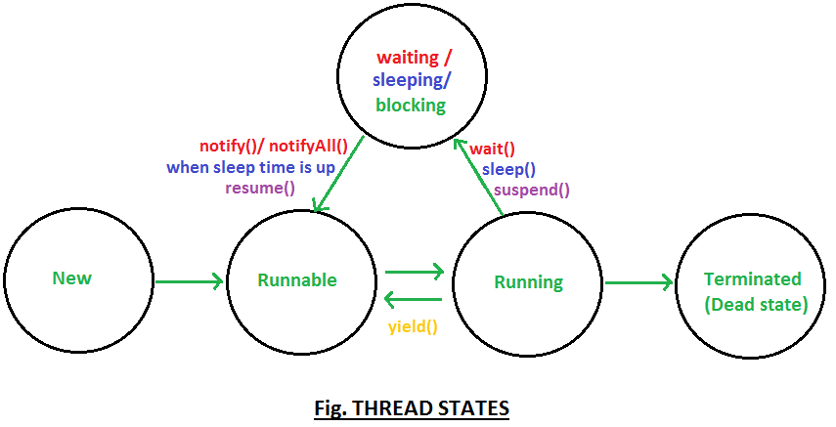
Thread States
start()
run()
new Thread()
Notes:
This is the state a thread is in when the thread scheduler selects it (from the runnable pool) to be the currently executing process.

Slide 8
Thread Methods
Start()
Run()
Yield
setPriority
setName
Sleep
join
Notes:
The scheduler in most JVMs uses preemptive, priority-based scheduling (which implies some sort of time slicing). This does not mean that all JVMs use time slicing.

Slide 9
Thread Shared Problem
Account -> ano = 1, bal = 10000
Supplier → Me(Shopkeeper) → Customers
Depositing money in my account - debit
Depositing money in my account – debit
C1 -> debit(2000) → 1
C2 -> debit(3000) →1
Account(1) C1 C2
10000 2000 3000
getbal -10000 getbal-10000
bal + amt sleep
sleep bal + 3000
setbal-12000 setbal – 13000
bal – 13000
15000 – actual
13000
12000
Notes:
The scheduler in most JVMs uses preemptive, priority-based scheduling (which implies some sort of time slicing). This does not mean that all JVMs use time slicing.

Slide 10
Thread Synchronization
When two different threads have access to a single instance of a class, and both threads invoke methods on that object...and those methods modify the state of the object?
It might corrupt an object's state (by changing its instance variable values in an inconsistent way), and if that object's state is data shared by other parts of the program, well, it's too scary to even visualize. So how do you protect the data? You must do two things:
Mark the variables private.
Synchronize the code that modifies the variables.

Slide 11
Synchronization Key Points
Only methods (or blocks) can be synchronized, not variables or classes.
Each object has just one lock.
Not all methods in a class need to be synchronized.
Once a thread acquires the lock on an object, no other thread can enter any of the synchronized methods in that class (for that object).
Multiple threads can still access the class's non-synchronized methods!
If a thread goes to sleep, it holds any locks it has—it doesn't release them.
A thread can acquire more than one lock..
You can synchronize a block of code rather than a method.
Notes:
For example, a thread can enter a synchronized method, thus acquiring a lock, and then immediately invoke a synchronized method on a different object, thus acquiring that lock as well. As the stack unwinds, locks are released again. Also, if a thread acquires a lock and then attempts to call a synchronized method on that same object, no problem. The JVM knows that this thread already has the lock for this object, so the thread is free to call other synchronized methods on the same object, using the lock the thread already has

Slide 12
How Synchronization Works
Internally Java uses a so called monitor also known as monitor lock or intrinsic lock in order to manage synchronization.
This monitor is bound to an object, e.g. when using synchronized methods each method share the same monitor of the corresponding object.
All implicit monitors implement the reentrant characteristics. Reentrant means that locks are bound to the current thread.
A thread can safely acquire the same lock multiple times without running into deadlocks (e.g. a synchronized method calls another synchronized method on the same object).

Slide 13
Locks
Instead of using implicit locking via the synchronized keyword the Concurrency API supports various explicit locks specified by the Lock interface.
Locks support various methods for finer grained lock control thus are more expressive than implicit monitors.
Multiple lock implementations are available in the standard JDK which will be demonstrated in the following sections.

Slide 14
ReentrantLock
The class ReentrantLock is a mutual exclusion lock with the same basic behavior as the implicit monitors accessed via the synchronized keyword but with extended capabilities.
As the name suggests this lock implements reentrant characteristics just as implicit monitors

Slide 15
ReentrantLock Examples
A lock is acquired via lock() and released via unlock().
Important to wrap code into a try/finally block to ensure unlocking in case of exceptions.
This method is thread-safe just like the synchronized counterpart.
If another thread has already acquired the lock subsequent calls to lock() pause the current thread until the lock has been unlocked.
Only one thread can hold the lock at any given time.
Locks support various methods for fine grained control lock.isLocked()); lock.isHeldByCurrentThread()); boolean locked = lock.tryLock();
ReentrantLock lock = new ReentrantLock();
int count = 0;
void increment() {
lock.lock();
try { count++; }
finally { lock.unlock();
} }
Notes:
The method tryLock() as an alternative to lock() tries to acquire the lock without pausing the current thread. The boolean result must be used to check if the lock has actually been acquired before accessing any shared mutable variables.

Slide 16
ReadWriteLock
The interface ReadWriteLock specifies another type of lock maintaining a pair of locks for read and write access.
The idea behind read-write locks is that it's usually safe to read mutable variables concurrently as long as nobody is writing to this variable.
So the read-lock can be held simultaneously by multiple threads as long as no threads hold the write-lock.
This can improve performance and throughput in case that reads are more frequent than writes.
Notes:
The method tryLock() as an alternative to lock() tries to acquire the lock without pausing the current thread. The boolean result must be used to check if the lock has actually been acquired before accessing any shared mutable variables.

Slide 17

Any Question ?

Slide 18

Thank you !

